Slide 1
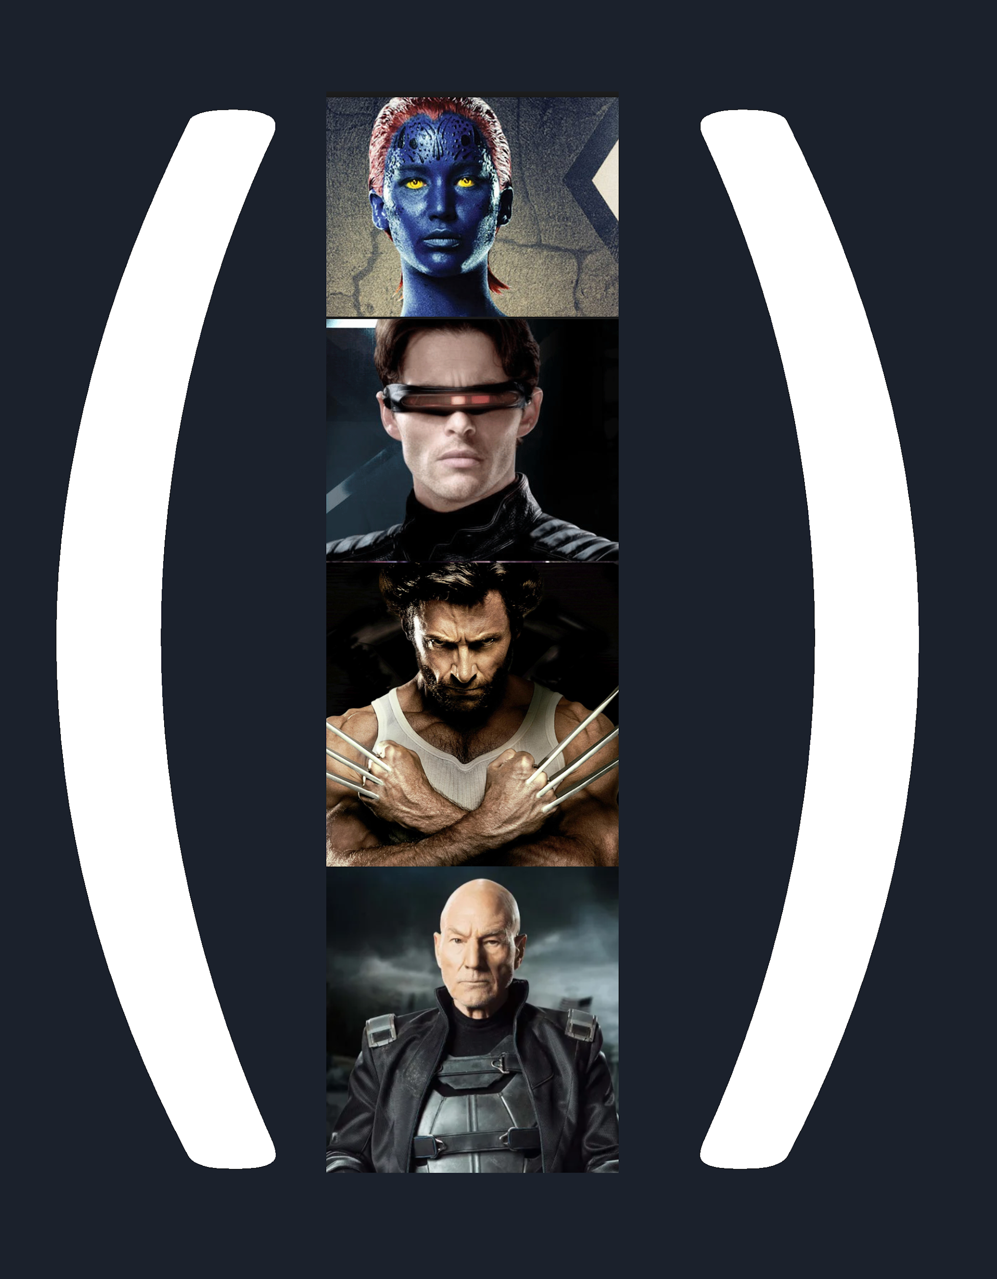
X-Vector embedding
A modern approach to vectorize speaker identity.

Slide 2
The need for embedding

Slide 3
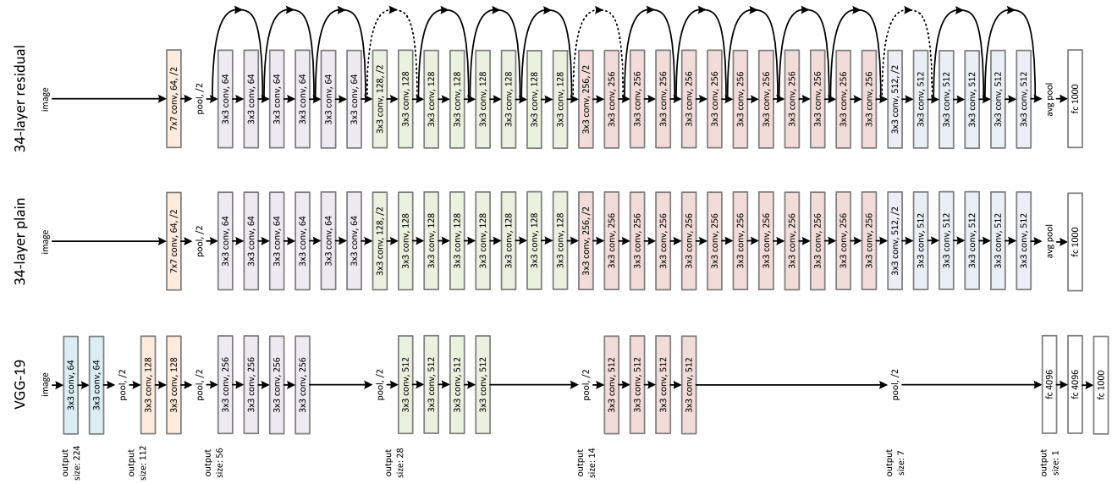
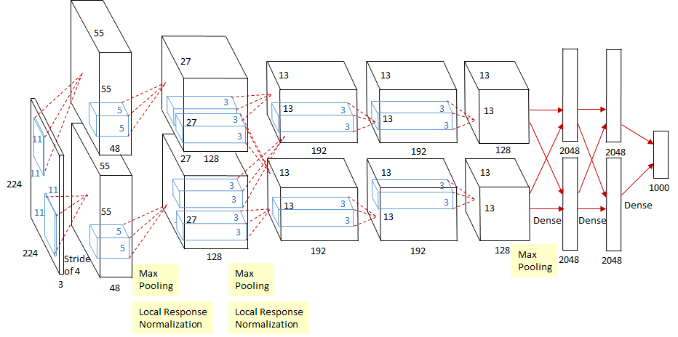
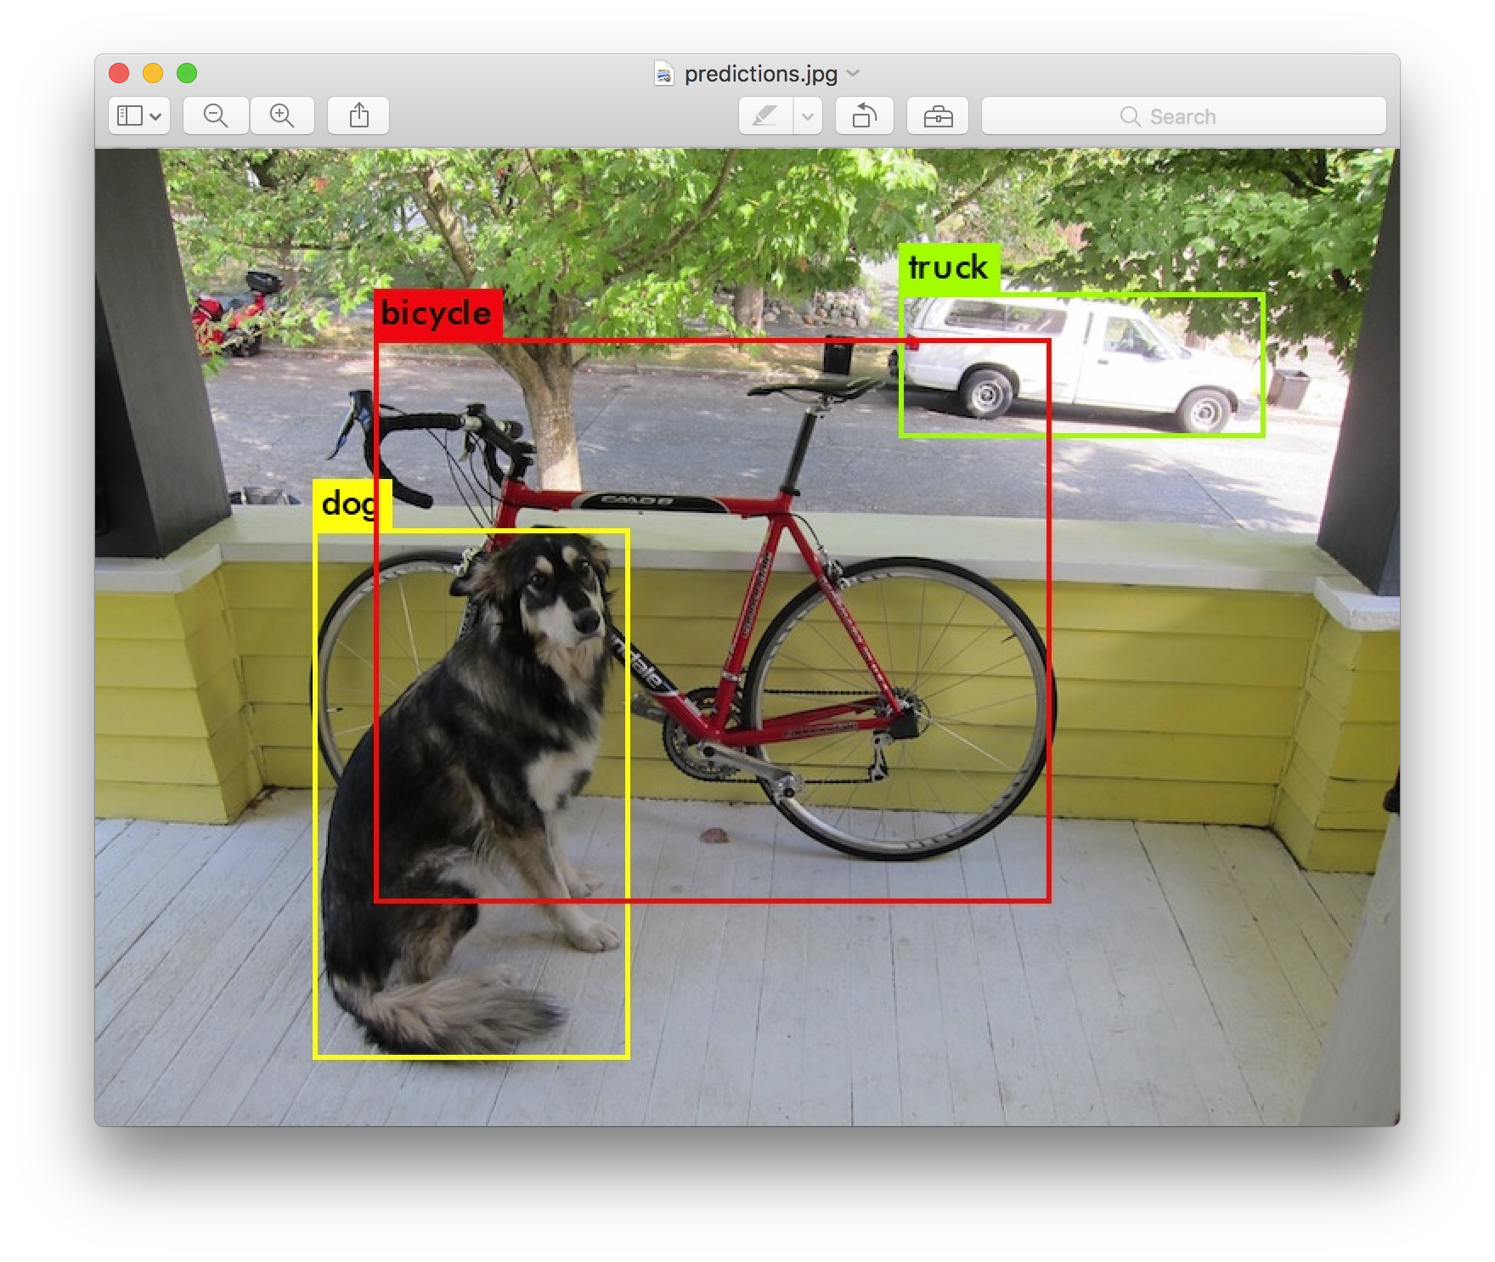
The state of the art of image recognition

Slide 4
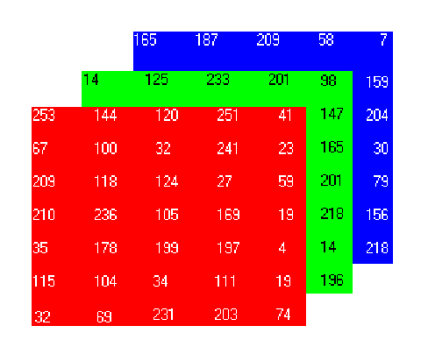
What are the input features ?
Well the image itself !
and we are done….

Slide 5
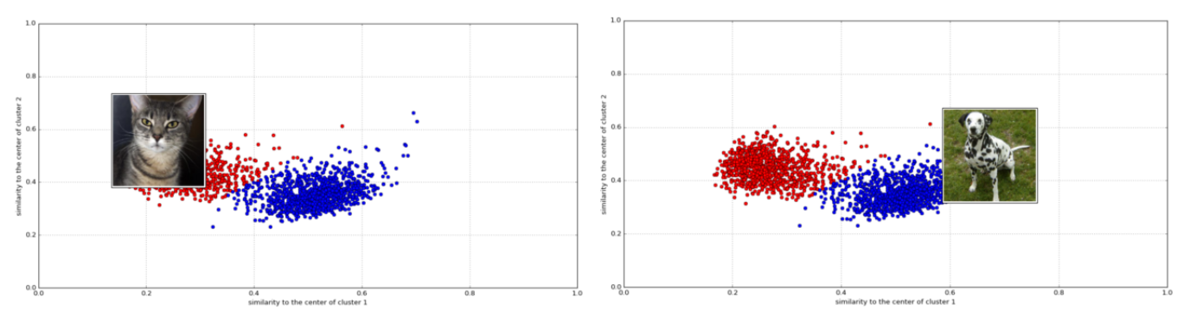
But what if we would like to cluster the images ?

Slide 6
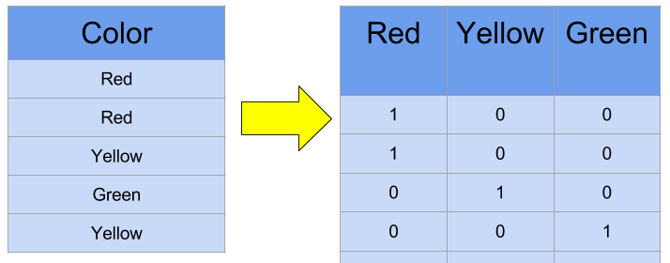
One step further….
one hot encoding ?
we just lost the semantic context of a word….
let’s say now that’s our input is a text

Slide 7
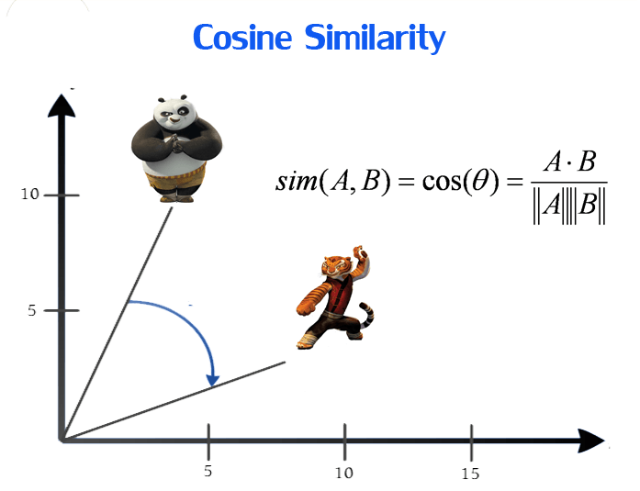
Our objective is to have words with similar context occupy close spatial positions.
Mathematically, the cosine of the angle between such vectors should be close to 1, i.e. angle close to 0.

Slide 8
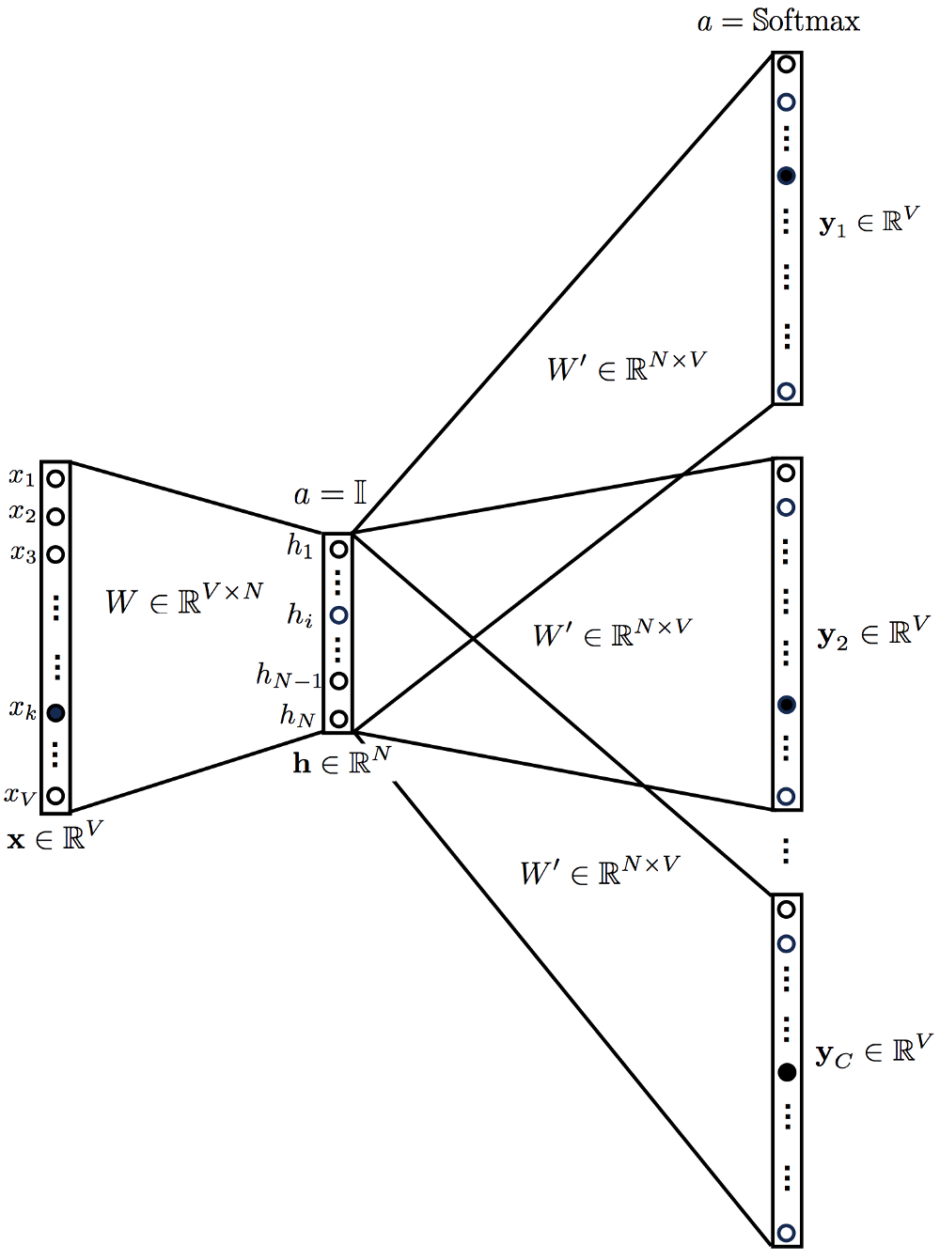
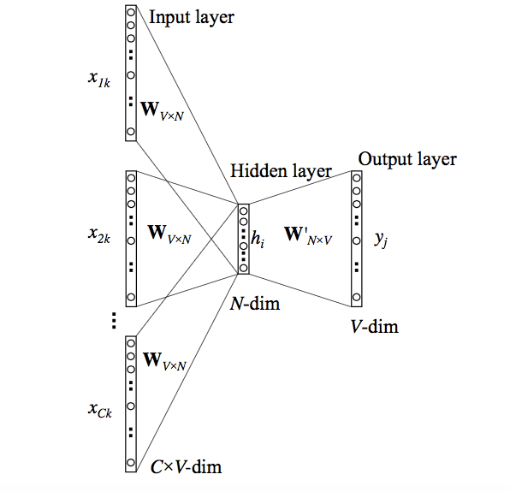
Word2vec came to help

Slide 9
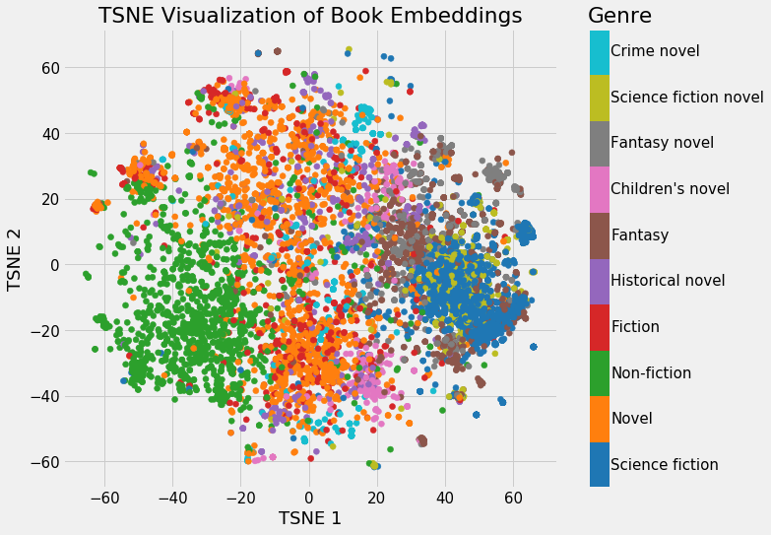
The need for fixed size embedding

Slide 10
And now for speech embedding

Slide 11
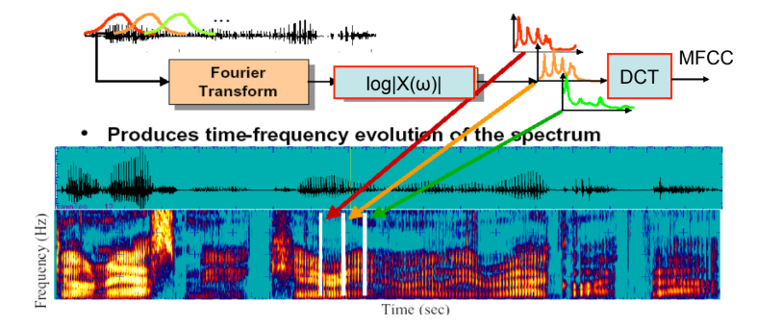
The first line of speech features
Speech is a time-varying signal conveying multiple layers of information
Words
Speaker
Language
Imotion

Slide 12
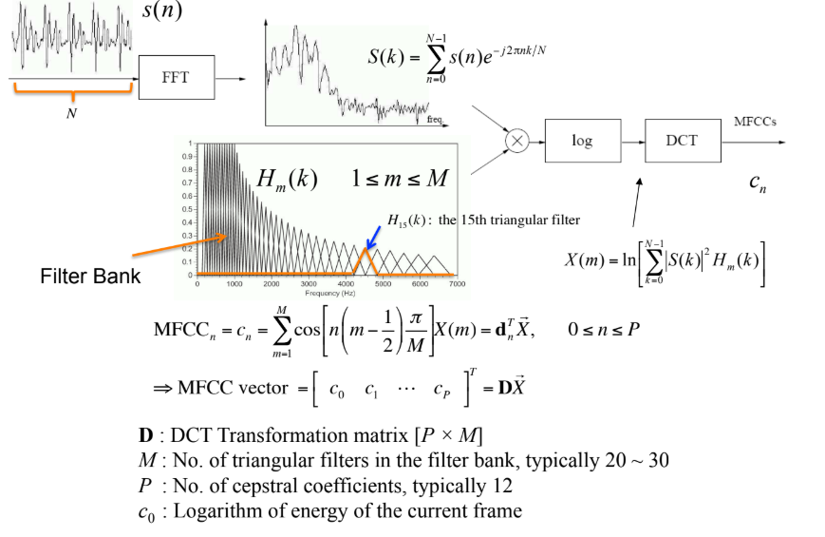
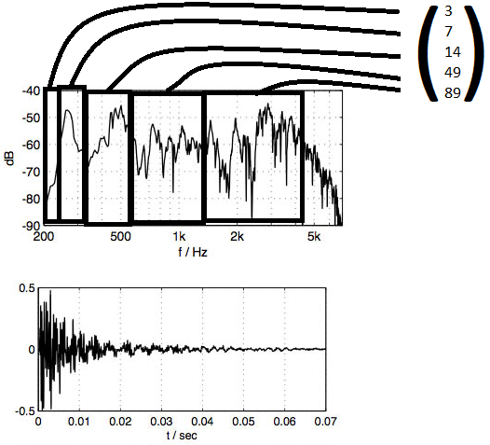
MFCC - Mel-frequency cepstrum

Slide 13
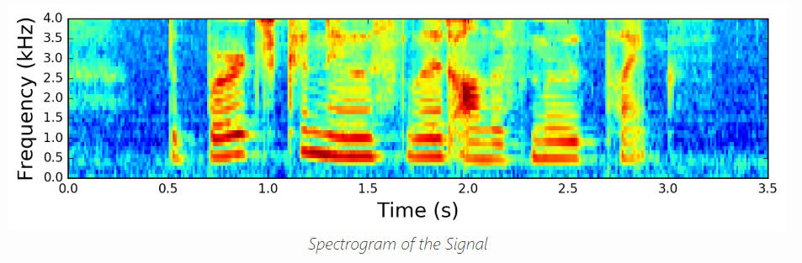
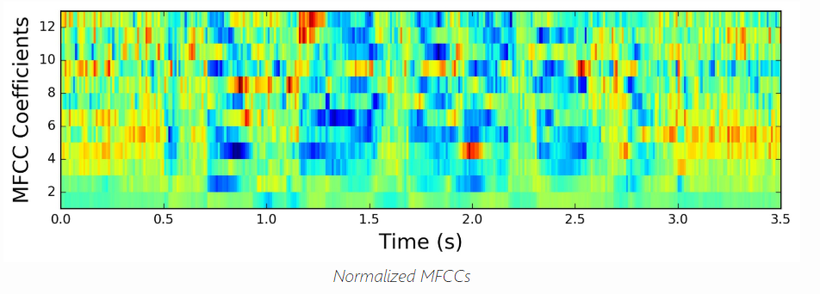
MFCC

Slide 14
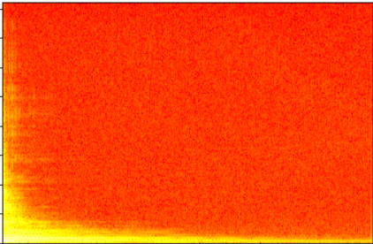

MFCC - Intuition
each musical instrument produces unique “fingerprint”
Acoustic guitar spectrogram vs MFCC

Slide 15
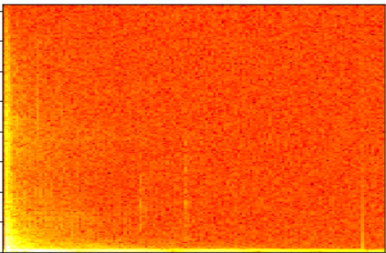

MFCC - Intuition
each musical instrument produces unique “fingerprint”
Bass drum spectrogram vs MFCC
for comparison

Slide 16
And now for the embedding part...

Slide 17
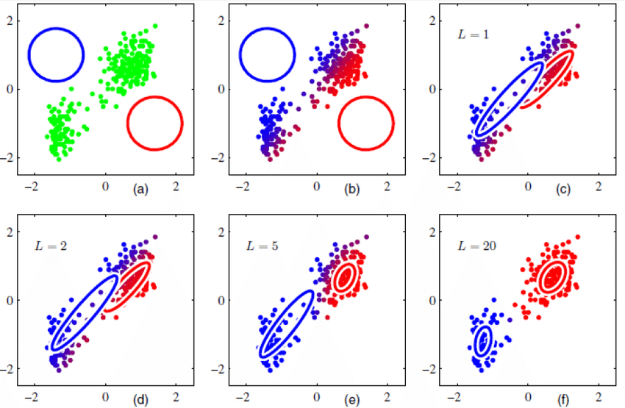
The pre Deep Learning era - The I-vector
Unsupervised embedding model
each point is a mfcc
UBM - GMM – Universal Background Model
Use MFCC as features
Use 2048 (standard value) Gaussians to describe each of the features

Slide 18
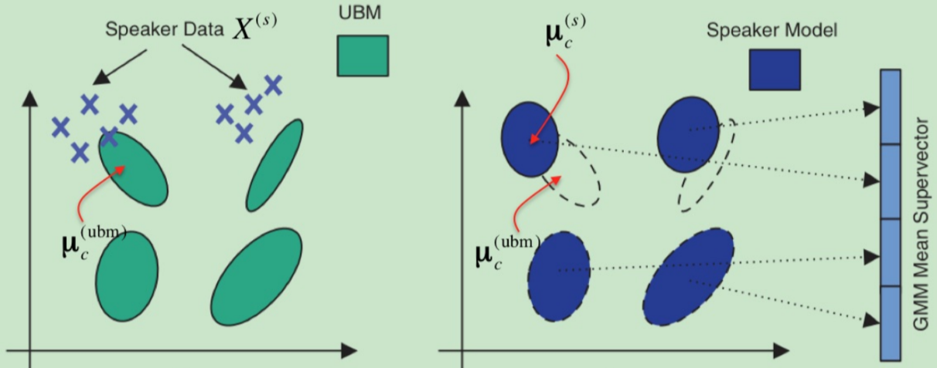
Adaptive GMM - Extract
The 65k parameters vector aka Super Vector, via dimensionality reduction the commonly I-vector is produced (using un/supervised methods) Ville Vestman, Tomi Kinnunen 2018
Adapt the UBM to the speaker using AGMM (using EM or MAP adaptation)

Slide 19
The X-vector

Slide 20
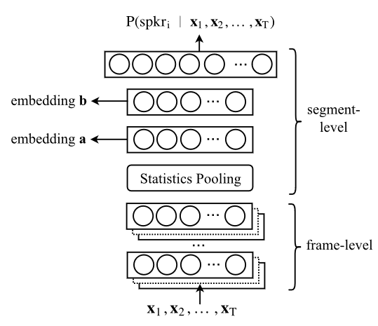
X - vector architecture
TDNN output vectors
x-vector consists of three main parts: - TDNN layers - Stats pooling - Fully connected layers

Slide 21
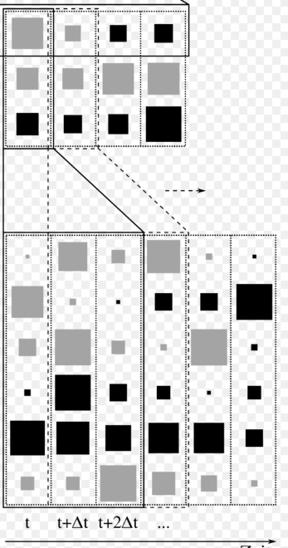
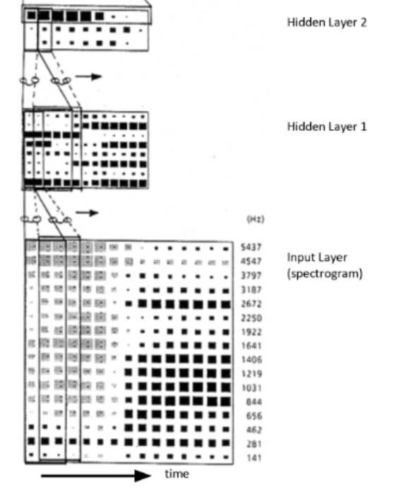
The TDNN - Time delay neural net

Slide 22
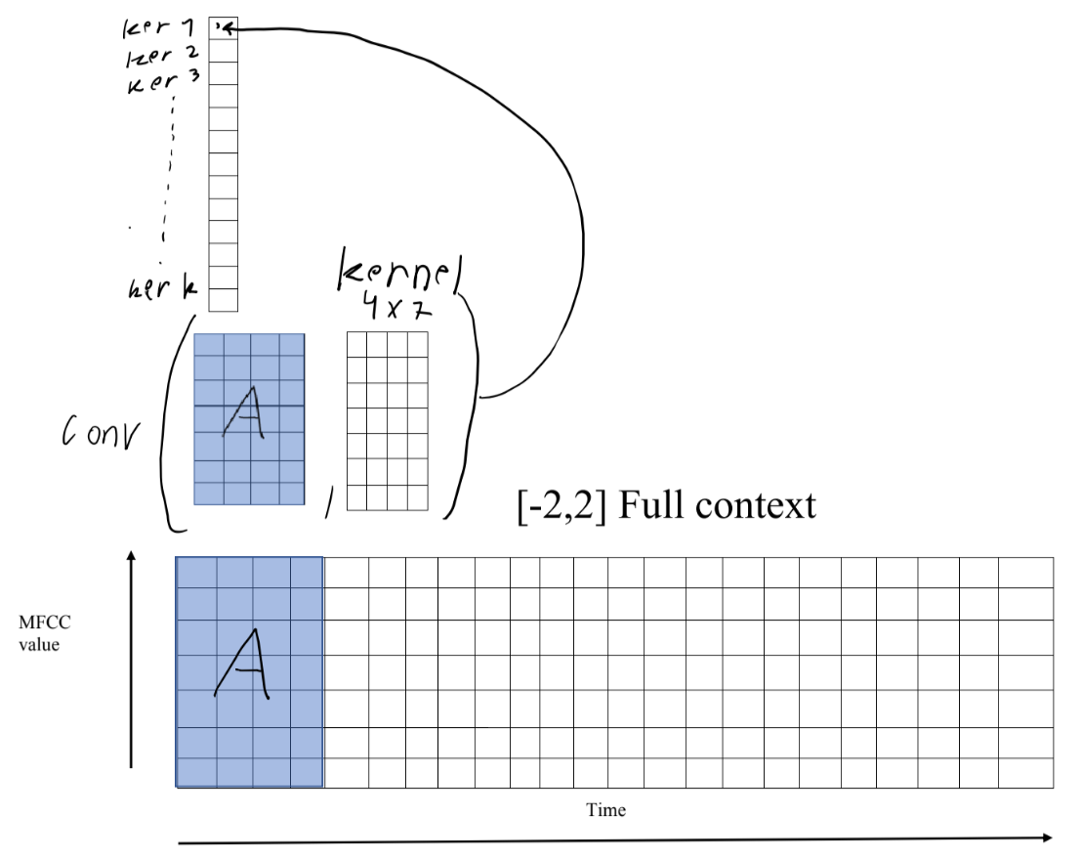
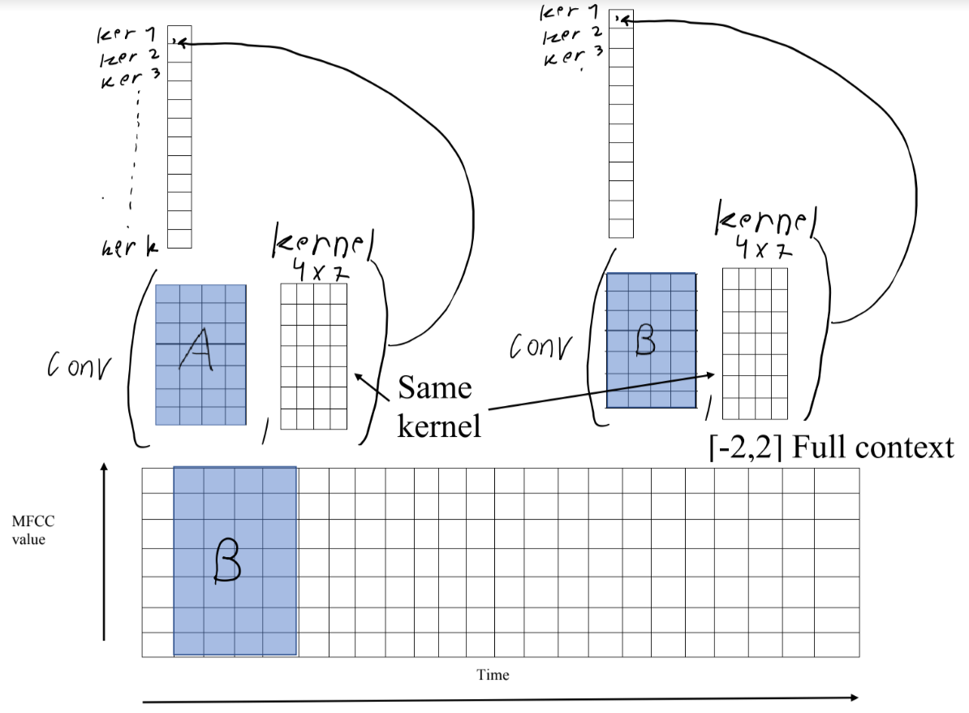
Implementation
using 1d convolution layer

Slide 23
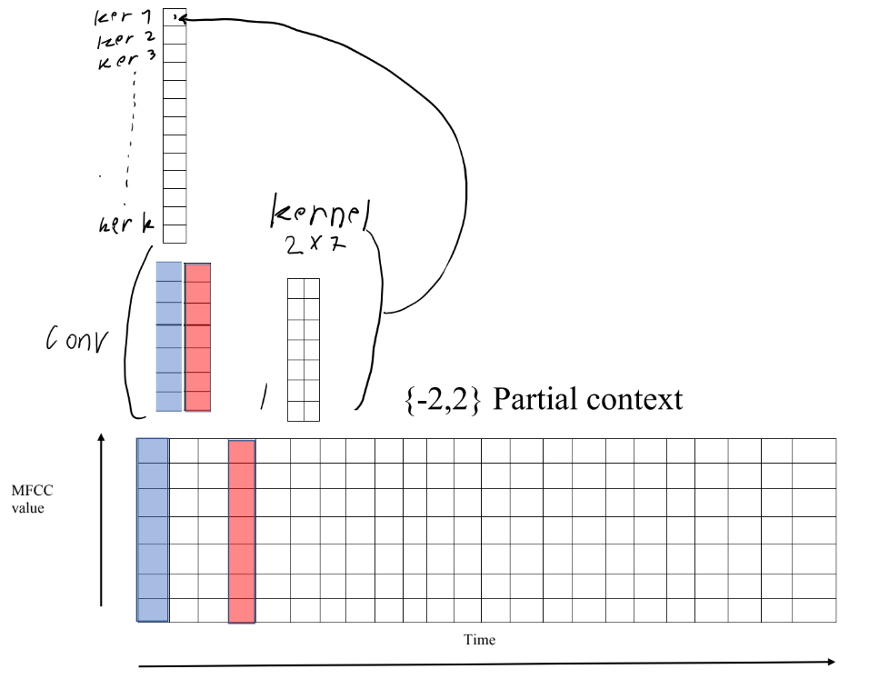
The TDNN
introduced the partial context
idea

Slide 24
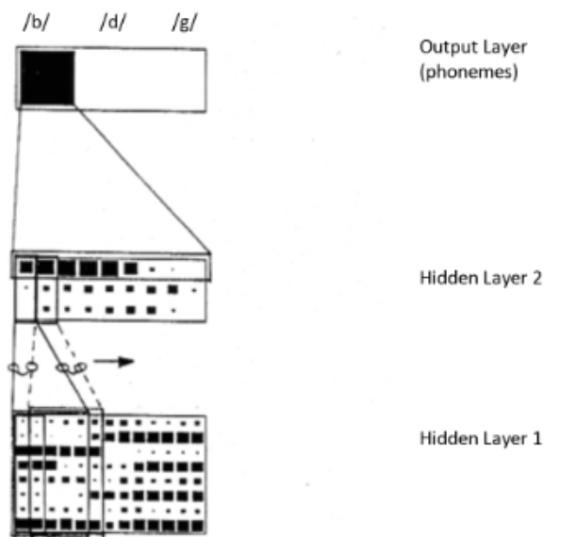
TDNN usage beside X-vectors
The TDNN could be used for phonemes recognition.
ALEXANDER WAIBEL et al
And even for keyword spotting
Ming Sun , David Snyder et al
Depending on the output layer of our
choice...

Slide 25
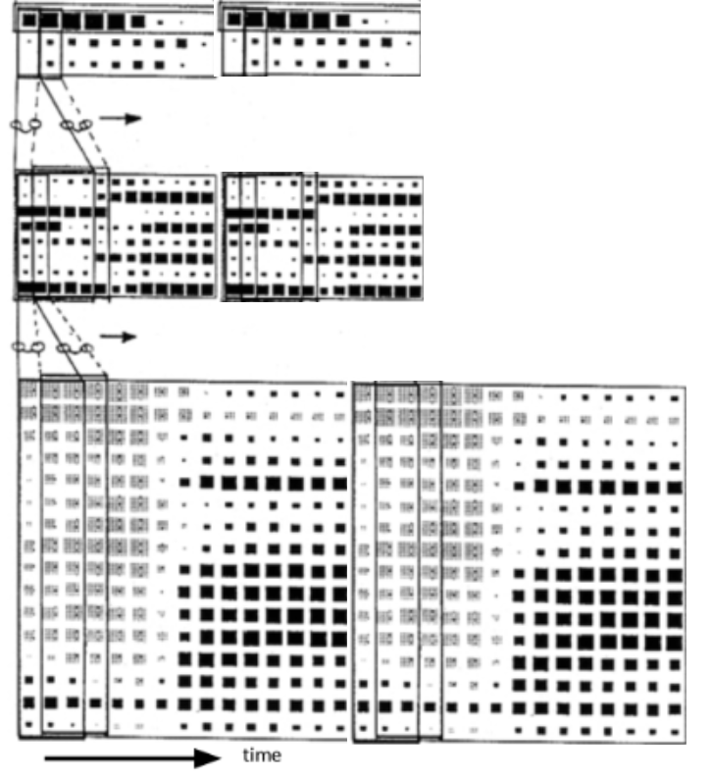
TDNN output vectors
Depending on the input length we will receive
dynamic length end layer.
Which means we still don’t have the fixed size vector that we wanted

Slide 26
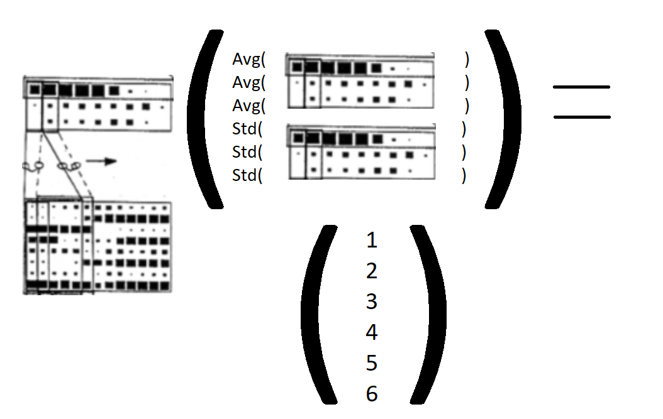
Statistics - pooling
Simply take the average and the standard deviation
for each channel of the final TDNN output and concatenate them
And now we got our desired fixed length vector

Slide 27
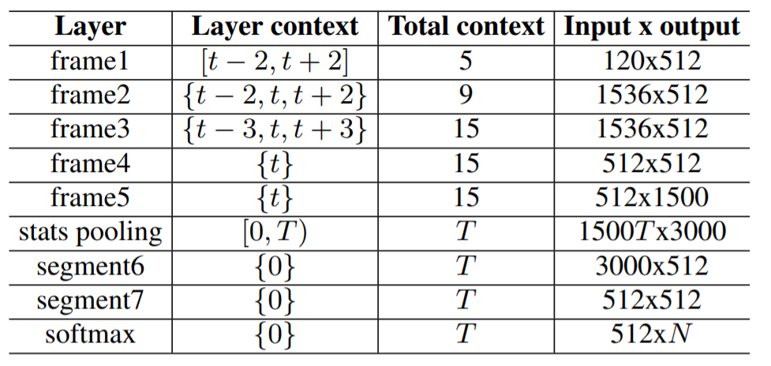
Two final steps and we have out x - vector
TDNN output vectors
The stats pooling layer output is than sent to two Fully - connected layers

Slide 28
Chopping the network head
After learning the network parameters we chop off the softmax layer, and forward propagate an input signal
X-Vector

Slide 29
Demonstration
The most common public implementation of X-vectors is using the Kaldi framework
Until now...

Slide 30
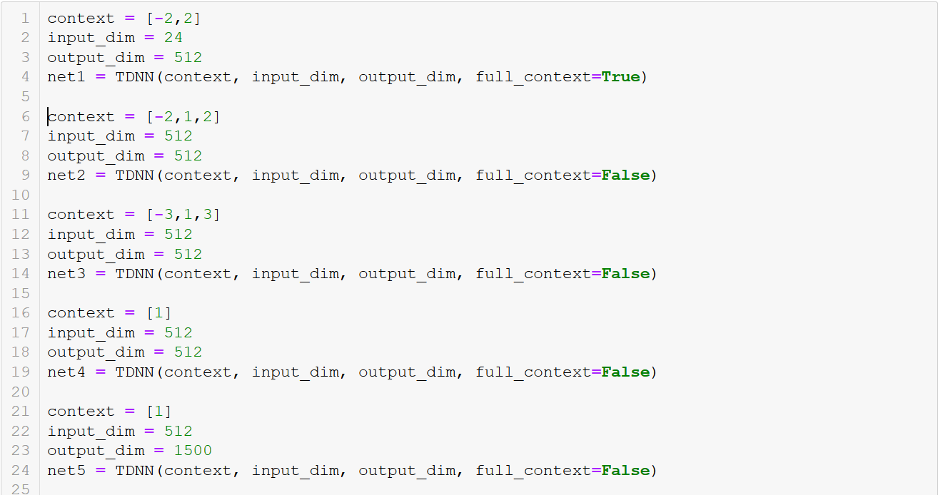
Pytorch implementation of X-vectors

Slide 31
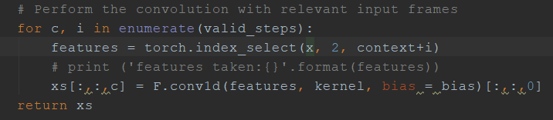
So how exactly is TDNN implemented ?

Slide 32
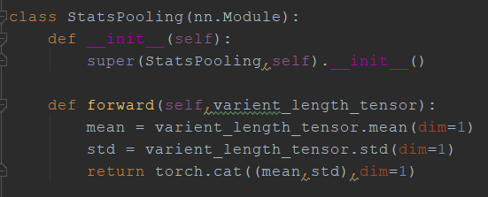
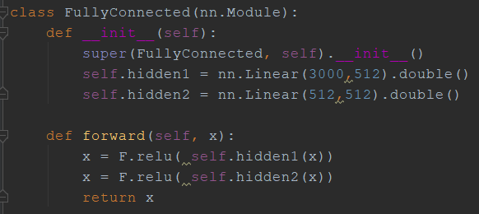
How the stats pooling and the final layers looks like ?

Slide 33
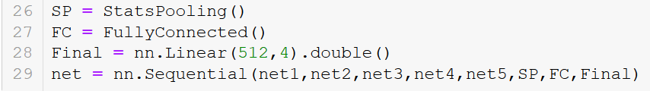
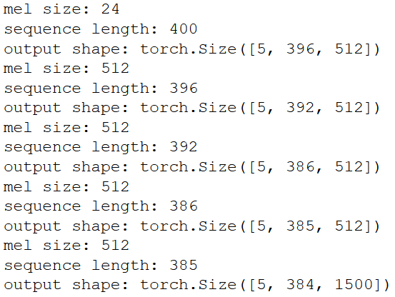
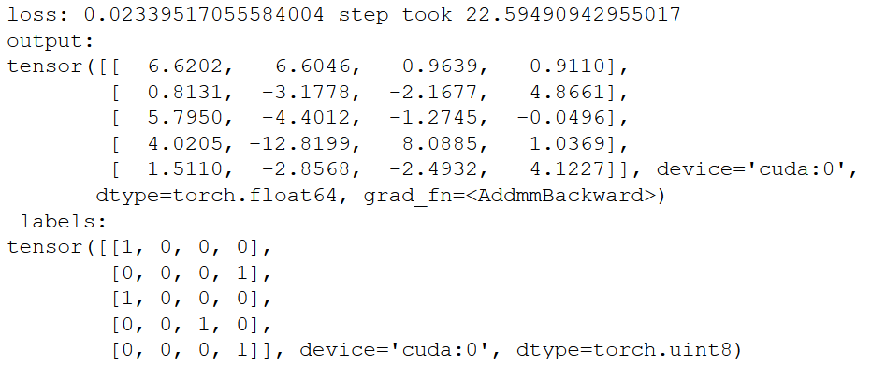
The Full network

Slide 34
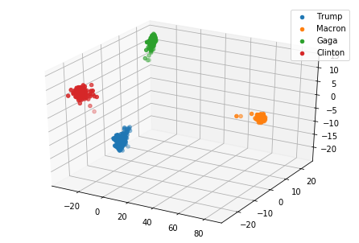
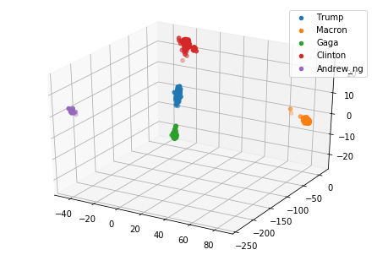
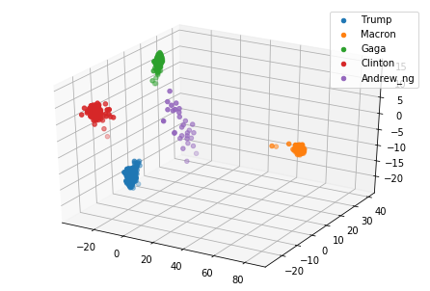
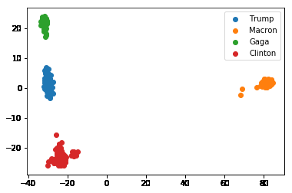
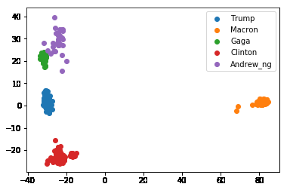
The x-vector embedding
LDA dimensionality reduction for visualization

Slide 35
https://github.com/Dannynis/xvector_pytorch

Slide 36
Questions ?

